Slide 1
Digital Modulation Techniques
UNIT 4 B
Prepared by
G. Balamurugan, MIT Campus

Slide 2
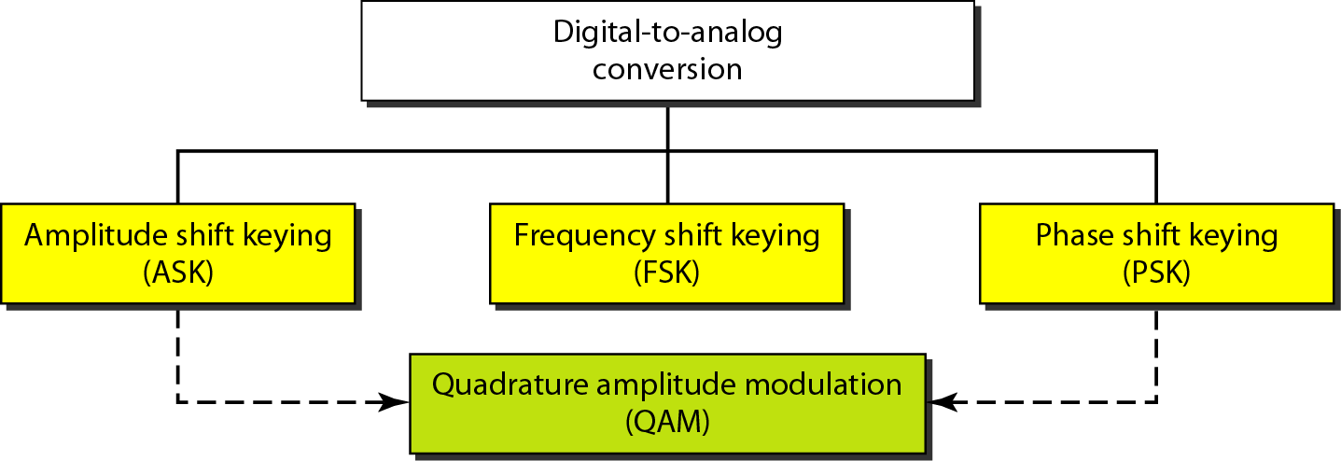
Digital Modulation Techniques

Slide 3
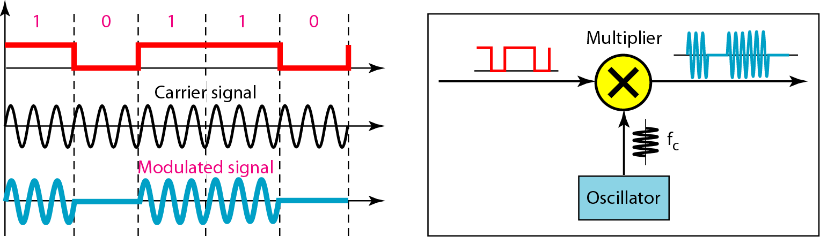
1. Amplitude Shift Keying (ASK)
ASK is implemented by changing the amplitude of a carrier signal to reflect amplitude levels in the digital signal.
For example: a digital “1” could not affect the signal, whereas a digital “0” would, by making it zero.
The line encoding will determine the values of the analog waveform to reflect the digital data being carried.
ASK Modulation - poor performance, [ It is heavily affected by noise, fading, and interference].
Application: ASK is used to transmit digital data over optical fiber

Slide 4
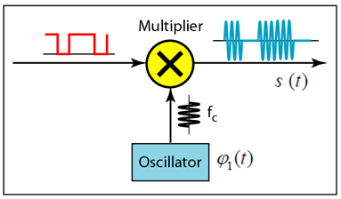

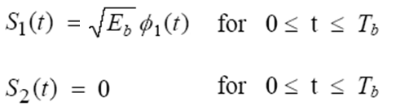

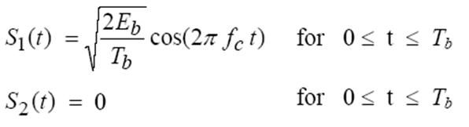
1. Amplitude Shift Keying (ASK)
Transmitter:
Bit ‘1’
Bit ‘0’
Bit ‘1’
Bit ‘0’
Where, Eb is the transmitted signal energy per bit

Slide 5
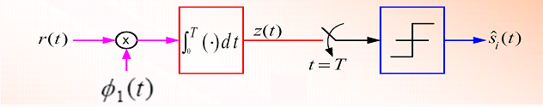
1. Amplitude Shift Keying (ASK)
Demodulation: only the presence or absence of a sinusoid in a given time interval needs to be determined
Receiver:
Bit ‘1’
Decision Device
z(t) > 0 , then bit 1
z(t) = 0 , then bit 0
Bit ‘0’

Slide 6
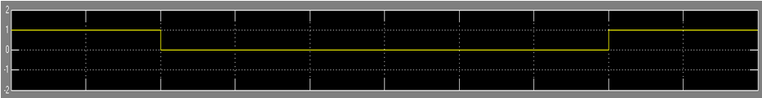
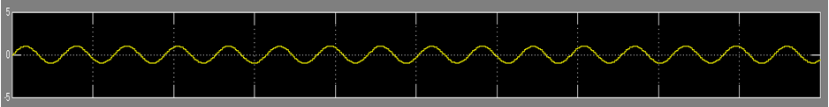
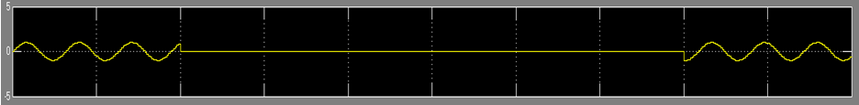
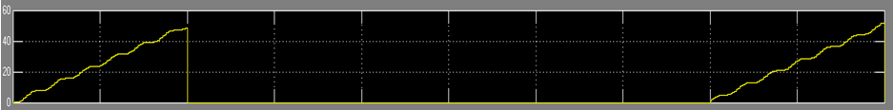
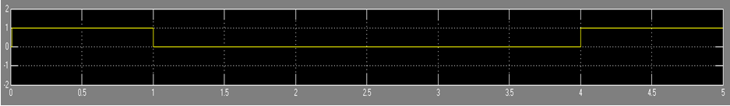

Slide 7
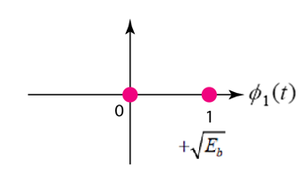
Constellation Diagram
ASK also called ON-OFF Keying (OOK))
A constellation diagram helps us to define the amplitude and phase of a signal when we are using two carriers, one in quadrature of the other.
The X-axis represents the in-phase carrier and the Y-axis represents quadrature carrier.

Slide 8
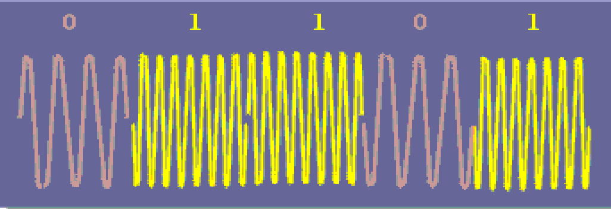
2. Frequency Shift Keying (FSK)
Frequency of the carrier is varied to represent digital data (binary 0/1)
Amplitude and phase remain constant.
Avoid noise interference by looking at frequencies (change of a signal) and ignoring amplitudes.

Slide 9
2. Frequency Shift Keying (FSK)
FSK waveform,
In BFSK, 2 different frequencies, f1 and f2 = f1 + ∆ f are used to transmit binary information.
Data is encoded in the frequencies
That is, m(t) is used to select between 2 frequencies:
f1 is the mark frequency, and f2 is the space frequency
Bit ‘1’
Bit ‘0’

Slide 10

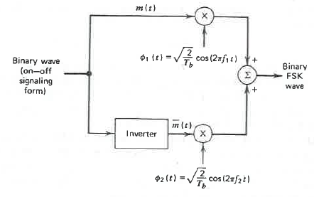
2. Frequency Shift Keying (FSK)
Transmitter:
Orthogonal basis function
Bit ‘1’
Bit ‘0’

Slide 11


Slide 12
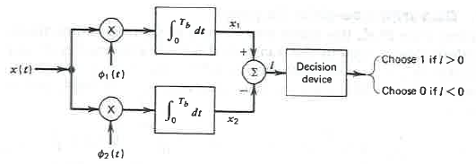







2. Frequency Shift Keying (FSK)
Receiver:

Slide 13
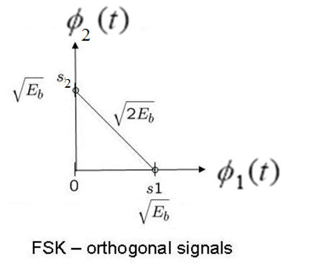
Constellation Diagram

Slide 14
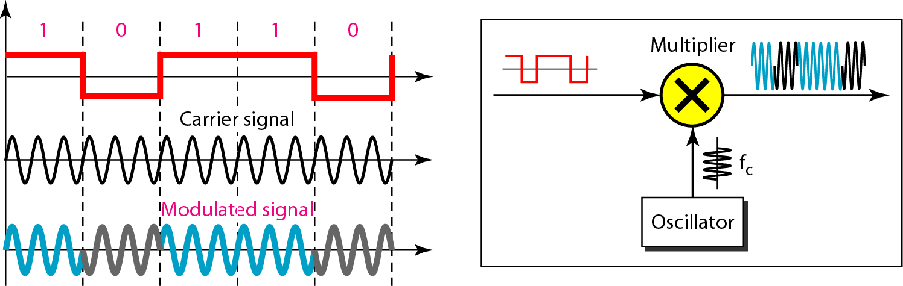
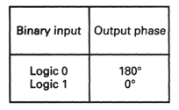
3. Binary Phase Shift Keying (BPSK)
Phase of the carrier is varied to represent digital data (binary 0 or 1)
Amplitude and frequency remains constant.
PSK is not susceptible to noise degradation that affects ASK or bandwidth limitations of FSK

Slide 15
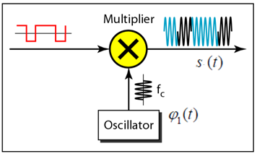



3. Binary Phase Shift Keying (BPSK)
Transmitter:
Bit ‘1’
Bit ‘0’

Slide 16
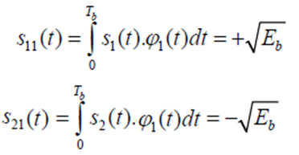
3. Binary Phase Shift Keying (BPSK)
Receiver:
Decision Device
z(t) > 0 , then bit 1
z(t) < 0 , then bit 0

Slide 17
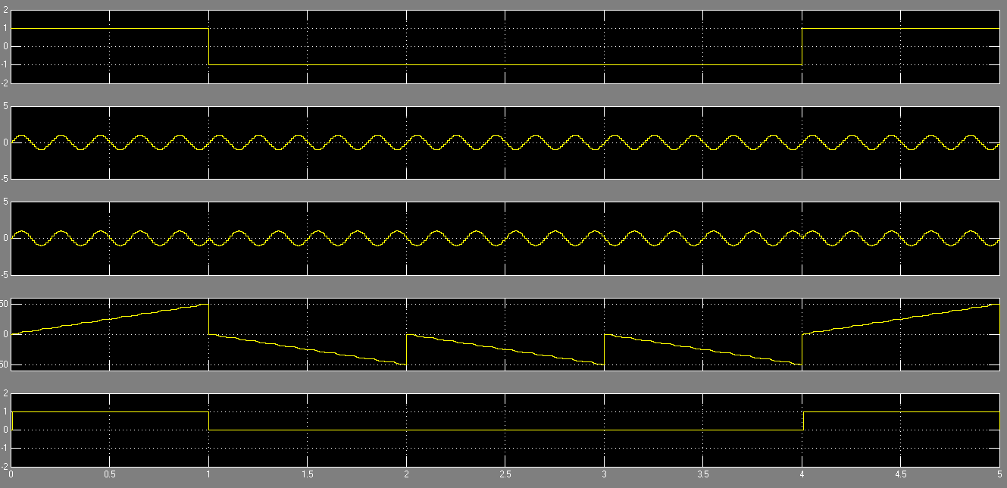

Slide 18
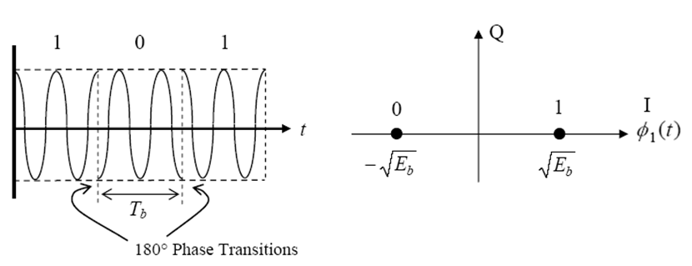
Constellation Diagram

Slide 19
M-ary Digital Modulation
4 ary PSK
8 ary PSK

Slide 20
4. M-ary PSK
QPSK - Mary = 4
Quadrature Phase Shift Keying (QPSK) can be interpreted as two independent BPSK systems (one on the I-channel and one on Q-channel), and thus the same performance but twice the bandwidth (spectrum) efficiency.
Efficient utilization of bandwidth
Phase of the sinusoidal carrier takes on one of the four equally spaced values [ pi/4 , 3pi/4, 5pi/4, 7pi/4].
Each one of the four equally spaced values corresponds to a unique pair of bits called dibit. 2 bits are transmitted per modulation symbol → Ts=2Tb)
p(t)
A
2T : Symbol period
T : Bit period
2T t

Slide 21
Signal space diagram for QPSK Modulation
Q -Channel
θ
I -Channel

Slide 22
QPSK
We can use trigonometric identities to show that
In terms of basis functions
We can write s_{i}(t) as

Slide 23



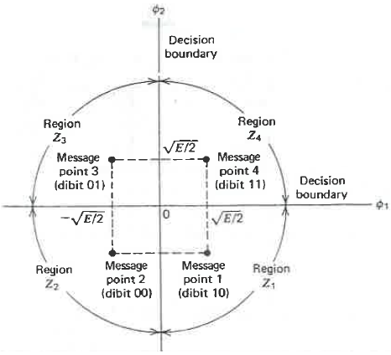
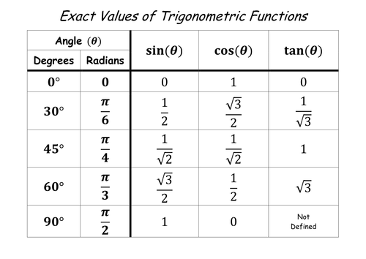


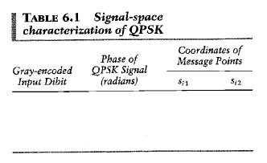
Signal Space Diagram
Each possible value of the phase corresponds to a unique pair of bits called dibit
Four message points

Slide 24
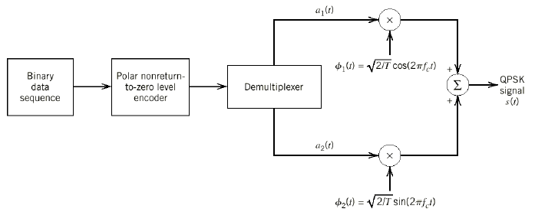
QPSK modulator
Transmitter:
General QPSK signal expression:

Slide 25

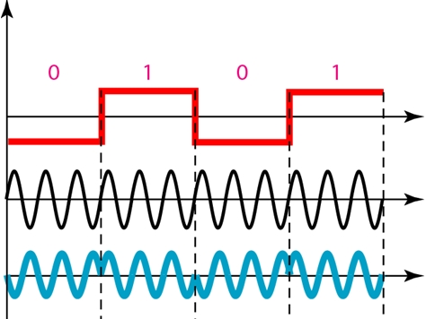
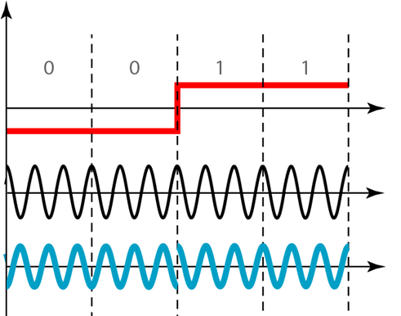
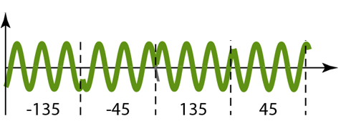
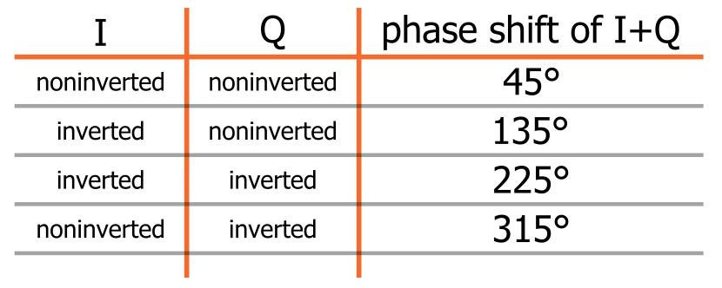
4. QPSK - Waveform
Message bits :
Odd Bits
Even Bits

Slide 26
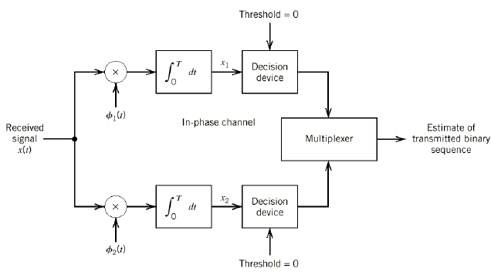




QPSK demodulator
Receiver:

Slide 27
M-ary PSK
PSK | M | Bits/symbol | Phase increment (2π / M)
BPSK | 2 | 1 | π (180⁰)
QPSK | 4 | 2 | π/2 (90⁰)
8-PSK | 8 | 3 | π/4 (45⁰)
16-PSK | 16 | 4 | π/8 (22.5⁰)

Slide 28
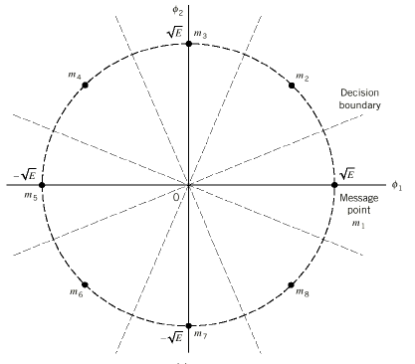
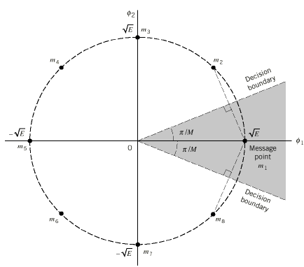
Signal Space Diagram (8PSK)

Slide 29
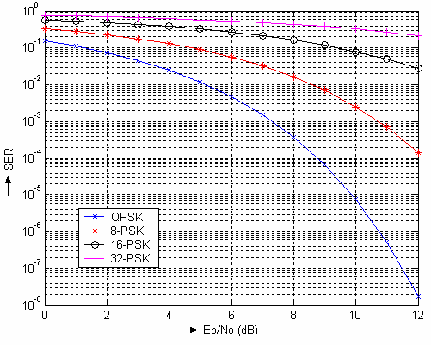
The error performance degrades significantly with increase in the number of symbols (M).
With increase in M, the decision region of a symbol narrows down and hence, smaller amount of noise may cause decision error.
M-ary modulation schemes have been popular for moderate values of ‘M’ such as 8 and16 because of their bandwidth efficiency.

Slide 30

Summary
BER ( Probability of error)
Bandwidth
With increase in M, the decision region of a symbol narrows down and hence, smaller amount of noise may cause decision error.
As ‘M’ increases = Quality of reception reduces
To increase the quality of reception then increase the transmission power
‘M’ increases = Efficient Bandwidth

Slide 31
Bit Error Rate Calculation (Using Constellation Diagram)
BPSK
BFSK
QPSK

Slide 32
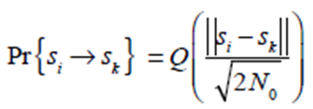
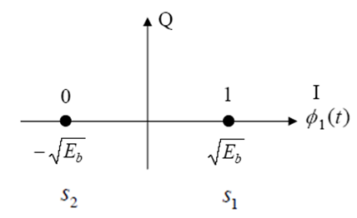
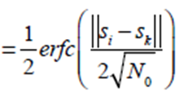


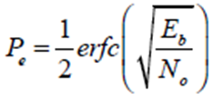

1. BPSK
The Q-function is used by communication engineers to determine the area under the tails of the Gaussian distribution.
BPSK Constellation
Euclidean Distance between the two symbols is
The probability of error for BPSK signal is
Notes:
The Q-function is used by communication engineers to determine the area under the tails of the Gaussian distribution.

Slide 33
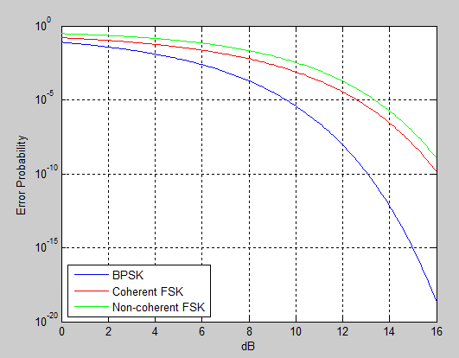


2. BFSK
BFSK Constellation
Euclidean Distance between the two symbols is
The probability of error for BFSK signal is

Slide 34
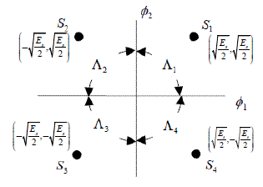
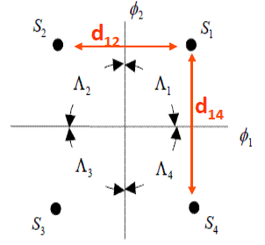
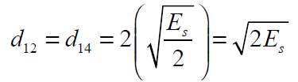



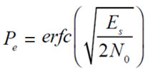
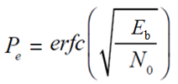
3. QPSK
Assume signal set size M=4; for equally probable transmission
Tight Union Bound – reduce overlap between decision regions.
Symbol error rate of QPSK is
Euclidean Distance between the two symbols are
In QPSK two bits per symbol.

Slide 35
Bit Error Rate Calculation (Using PDF)
BPSK
BFSK
QPSK

Slide 36
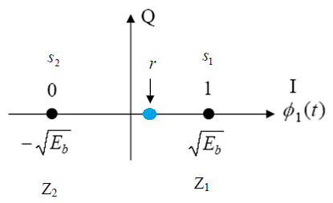
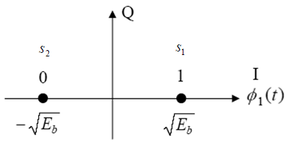
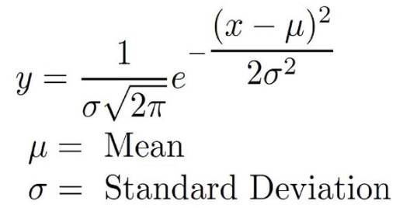



1. BPSK (Using PDF)
We observe that, an error occurs if
s1(t) is transmitted while r is in Z2
s2(t) is transmitted while r is in Z1
‘r’ denotes output of the correlator of BPSK demodulator
Assume ‘0’has been transmitted, then the likelihood function is,
Variance = (N0/2)
The conditional PDF for P(z/s1) and p(z/s2) with mean values are a1 and a2 respectively

Slide 37








1. BPSK (Using PDF)

Slide 38


1. BPSK (Using PDF)
Following a similar approach as above, we can determine the probability of error when ‘1’ is transmitted from the modulator,
‘0’s and ‘1’s are equally likely to occur at the input of the modulator and hence, the average probability of a received bit

Slide 39
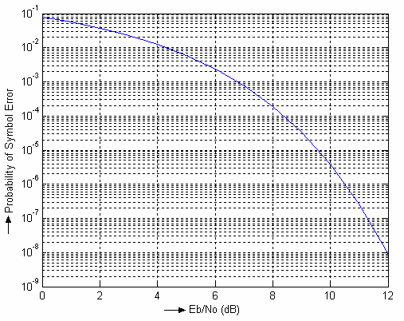

Slide 40

2. BFSK (Using PDF)
L = (r1 – r2) > 0
r1 is +√Eb while the output of the lower correlator, i.e. r2 is zero.
When we consider additive noise, ‘L’ represents a random variable whose mean is +√Eb if message ‘1’ is transmitted. For message ‘0’, the mean of ‘L’ is -√Eb
r1 and r2 are independent and identically distributed random variables with the same variance No / 2
Assume ‘0’has been transmitted, then the likelihood function is,

Slide 41






2. BFSK (Using PDF)

Slide 42




2. BFSK (Using PDF)
Following a similar approach as above, we can determine the probability of error when ‘1’ is transmitted from the modulator,
‘0’s and ‘1’s are equally likely to occur at the input of the modulator and hence, the average probability of a received bit

Slide 43
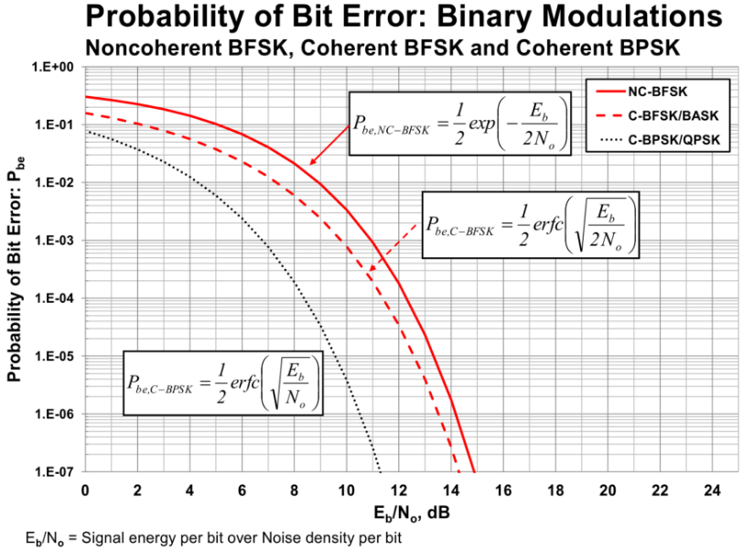

Slide 44


3. QPSK (Using PDF)
To calculate the average probability of symbol error, the QPSK system is in fact equivalent to two binary PSK systems working in parallel and using two carriers that are in phase quadrature.
These two binary PSK systems may be characterized as follows:
The signal energy per bit is E/2.
The noise spectral density is N0/2.
Thus average probability of bit error in each channel of QPSK system is,

Slide 45



3. QPSK (Using PDF)
Then, the average probability of a correct decision resulting from the combined action of two channels
Average probability of symbol error for QPSK system is

Slide 46




3. QPSK (Using PDF)
In the region (E /2No) >> 1, so we may ignore the second term on the right side of the above equation.
In QPSK two bits per symbol.

Slide 47









Problem 1
A binary receiver system receives a bit rate of 1Mbps. The waveform amplitude is 5mV and the noise power spectral density is 0.5x10^-11 W/Hz. Calculate the average bit error probability for BPSK and BFSK modulation schemes.
For BPSK
For BFSK
For BPSK
For BFSK

Slide 48



Problem 2
A 1Mbps BPSK receiver detects waveform of amplitude 1mV. The noise power spectral density is 10^-11 W/Hz.
What will be the average bit error probability?
What should be the average received signal power to maintain an error probability of 2X 10^-3?
For BPSK
Solution A:

Slide 49





Problem 2
Solution B:
To maintain an error probability
From Q table,

Slide 50
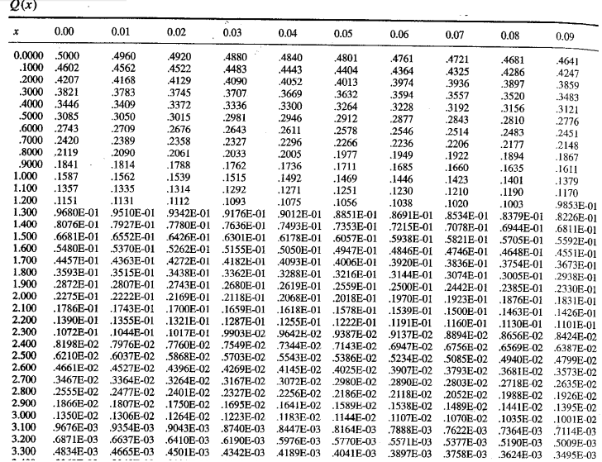

Slide 51
Power Spectral Density (PSD)
BPSK
QPSK
BFSK

Slide 52


1. BPSK
Input message is polar NRZ, then power spectral density is
Symbol shaping function
The energy spectral density of a fourier transformable g(t) is defined as the square magnitude of the signal’s Fourier transform.

Slide 53





Bandwidth of BPSK is 2fb
Bandwidth for M-ary PSK

Slide 54



2. QPSK
Two bits are modulated simultaneously
For BPSK
For QPSK [ 2 BPSK ]

Slide 55


For BPSK
For QPSK
For MPSK
Bandwidth of BPSK is 2fb
Bandwidth of QPSK is fb
Bandwidth of MPSK is 2fb / log2M

Slide 56
3. BFSK

Slide 57


Slide 58

Performance Comparison of Various Digital Modulation Schemes (BER = 10^-6 )

Slide 59
Problem
Assume that bandwidth of 20kHz is available. Each user transmits the data at a rate of 5kbps. Find the number of users can be accommodated for BPSK, QPSK, 8PSK and 16PSK modulation techniques?
Solution:
Bandwidth of BPSK is 2fb
Bandwidth of QPSK is fb
Rate for 1 user : 5kbps
Rate for 1 user : 5kbps
R=1/Tb
R=1/Tb
Bandwidth for one user = 2 x (5kHz) = 10kHz
Bandwidth for one user = 1 x (5kHz) = 5kHz
one user BW x Y = Total available BW
one user BW x Y = Total available BW
Only 2 users can be accommodated .
Only 4 users can be accommodated .

Slide 60
Problem
Bandwidth of MPSK is 2fb / log2M
Bandwidth of 8PSK is 2fb / 3
Bandwidth of 16PSK is 2fb / 4
Rate for 1 user : 5kbps
Rate for 1 user : 5kbps
R=1/Tb
R=1/Tb
Bandwidth for one user = (2/3) x (5kHz)
= 3.3kHz
Bandwidth for one user = (2/4) x (5kHz)
= 2.5kHz
one user BW x Y = Total available BW
one user BW x Y = Total available BW
Only 6 users can be accommodated .
Only 8 users can be accommodated .

